Slide 1



Lumio English
LESSON
17
AT THE PARK
slide • swing • tree • flower • bench • ball • kite • park
LEVEL 1 · 8 NEW WORDS
Notes:
Welcome the class. Today: At the Park. Goal: I can talk about activities at the park..

Slide 2



Lumio English
Welcome to Lumio English
2 / 29
Hello, little star!
Teacher says:
"Hello! Today we learn 8 new words!"
Notes:
Warm greeting. Set a positive, energetic tone.

Slide 3


Lumio English
Today's Goals
3 / 29
By the end, you will:
1. Say 8 new words
2. I can talk about activities at the park.
3. Play games and earn stars
Notes:
Read goals aloud. Keep energy up.

Slide 4


Lumio English
Warm-up • At the Park
4 / 29
Let's get ready!
Stand up and stretch!
Say hello to a friend.
Clap your hands three times!
Notes:
2-3 minutes, high energy, physical movement.

Slide 5

Lumio English
Words for Today
5 / 29
8 new words
slide — زحليقة
swing — أرجوحة
tree — شجرة
flower — زهرة
bench — مقعد
ball — كرة
kite — طائرة ورقية
park — حديقة
Notes:
Preview words quickly. Don't teach yet, just build excitement.

Slide 6
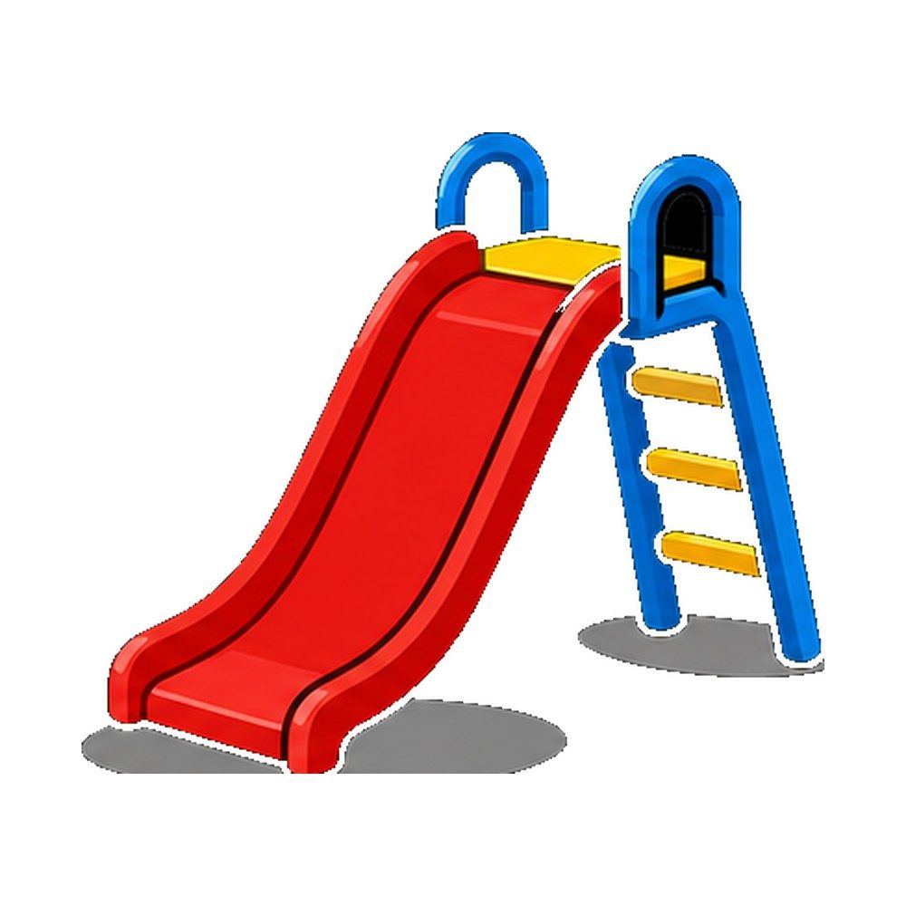
Lumio English
Vocabulary • slide
6 / 29
slide
زحليقة
SAY IT
"I play on the slide."
Listen → Repeat ×3
Notes:
Model "slide" x2, choral repeat x3. Meaning: زحليقة. Sentence: I play on the slide..

Slide 7


Lumio English
Practice • slide
7 / 29
Can you say it?
"I play on the slide."
زحليقة
Notes:
Call on a student. Give first-sound hint if needed: "s..."

Slide 8
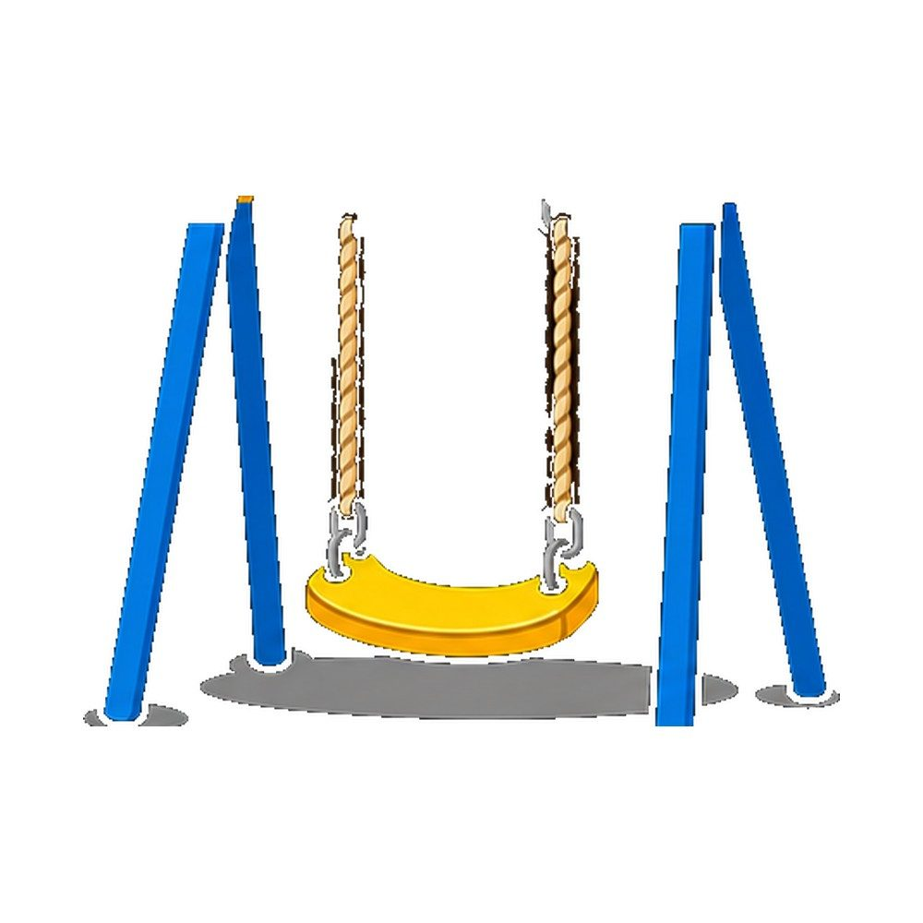

Lumio English
Vocabulary • swing
8 / 29
swing
أرجوحة
SAY IT
"I play on the swing."
Listen → Repeat ×3
Notes:
Model "swing" x2, choral repeat x3. Meaning: أرجوحة. Sentence: I play on the swing..

Slide 9
Lumio English
Practice • swing
9 / 29
Can you say it?
"I play on the swing."
أرجوحة
Notes:
Call on a student. Give first-sound hint if needed: "s..."

Slide 10

Lumio English
Vocabulary • tree
10 / 29
tree
شجرة
T
R
E
E
SAY IT
"It is a tree."
Listen → Repeat ×3
Notes:
Model "tree" x2, choral repeat x3. Meaning: شجرة. Sentence: It is a tree..

Slide 11
Lumio English
Practice • tree
11 / 29
Can you say it?
"It is a tree."
شجرة
Notes:
Call on a student. Give first-sound hint if needed: "t..."

Slide 12

Lumio English
Vocabulary • flower
12 / 29
flower
زهرة
SAY IT
"It is a flower."
Listen → Repeat ×3
Notes:
Model "flower" x2, choral repeat x3. Meaning: زهرة. Sentence: It is a flower..

Slide 13
Lumio English
Practice • flower
13 / 29
Can you say it?
"It is a flower."
زهرة
Notes:
Call on a student. Give first-sound hint if needed: "f..."

Slide 14

Lumio English
Vocabulary • bench
14 / 29
bench
مقعد
SAY IT
"Sit on the bench."
Listen → Repeat ×3
Notes:
Model "bench" x2, choral repeat x3. Meaning: مقعد. Sentence: Sit on the bench..

Slide 15
Lumio English
Practice • bench
15 / 29
Can you say it?
"Sit on the bench."
مقعد
Notes:
Call on a student. Give first-sound hint if needed: "b..."

Slide 16
Lumio English
Vocabulary • ball
16 / 29
ball
كرة
B
A
L
L
SAY IT
"I play with a ball."
Listen → Repeat ×3
Notes:
Model "ball" x2, choral repeat x3. Meaning: كرة. Sentence: I play with a ball..

Slide 17
Lumio English
Practice • ball
17 / 29
Can you say it?
"I play with a ball."
كرة
Notes:
Call on a student. Give first-sound hint if needed: "b..."

Slide 18
Lumio English
Vocabulary • kite
18 / 29
kite
طائرة ورقية
K
I
T
E
SAY IT
"I fly a kite."
Listen → Repeat ×3
Notes:
Model "kite" x2, choral repeat x3. Meaning: طائرة ورقية. Sentence: I fly a kite..

Slide 19
Lumio English
Practice • kite
19 / 29
Can you say it?
"I fly a kite."
طائرة ورقية
Notes:
Call on a student. Give first-sound hint if needed: "k..."

Slide 20

Lumio English
Vocabulary • park
20 / 29
park
حديقة
SAY IT
"I go to the park."
Listen → Repeat ×3
Notes:
Model "park" x2, choral repeat x3. Meaning: حديقة. Sentence: I go to the park..

Slide 21
Lumio English
Practice • park
21 / 29
Can you say it?
"I go to the park."
حديقة
Notes:
Call on a student. Give first-sound hint if needed: "p..."

Slide 22

Lumio English
Listen and Repeat
22 / 29
My turn, your turn!
1. slide
2. swing
3. tree
4. flower
5. bench
6. ball
7. kite
8. park
Notes:
Point and say each word, students repeat.

Slide 23

Lumio English
Your Turn • Round 1 of 3
23 / 29
What is this?
Notes:
Call a student by name. Answer: slide (زحليقة). Hint if needed: "s..."

Slide 24
Lumio English
Your Turn • Round 2 of 3
24 / 29
What is this?
Notes:
Call a student by name. Answer: swing (أرجوحة). Hint if needed: "s..."

Slide 25
Lumio English
Your Turn • Round 3 of 3
25 / 29
T
R
E
E
What is this?
Notes:
Call a student by name. Answer: tree (شجرة). Hint if needed: "t..."

Slide 26

Lumio English
Game • Quiz 1 of 2
26 / 29
Which word means "طائرة ورقية"?
A
B
C
swing
slide
kite
Notes:
Answer: kite. Count down 5-4-3-2-1 for excitement.

Slide 27
Lumio English
Game • Quiz 2 of 2
27 / 29
Which word means "حديقة"?
A
B
C
slide
bench
park
Notes:
Answer: park. Count down 5-4-3-2-1 for excitement.

Slide 28


Lumio English
Reward Time
28 / 29
Great job!
★ ★ ★ ★ ★
You earned 5 stars!
Play Lesson 17 online to keep your streak!
Notes:
Celebrate! Praise students by name if time allows.

Slide 29

Lumio English
Homework & Goodbye
29 / 29
See you next time!
1. Play Lesson 17 on Lumio English
2. Say each word to your family
3. Earn your three stars!
Notes:
Assign homework. Warm goodbye.

